Slide 1








Thank you to our sponsors!
Gold Sponsors
Silver Sponsors
Community Sponsors

Slide 2


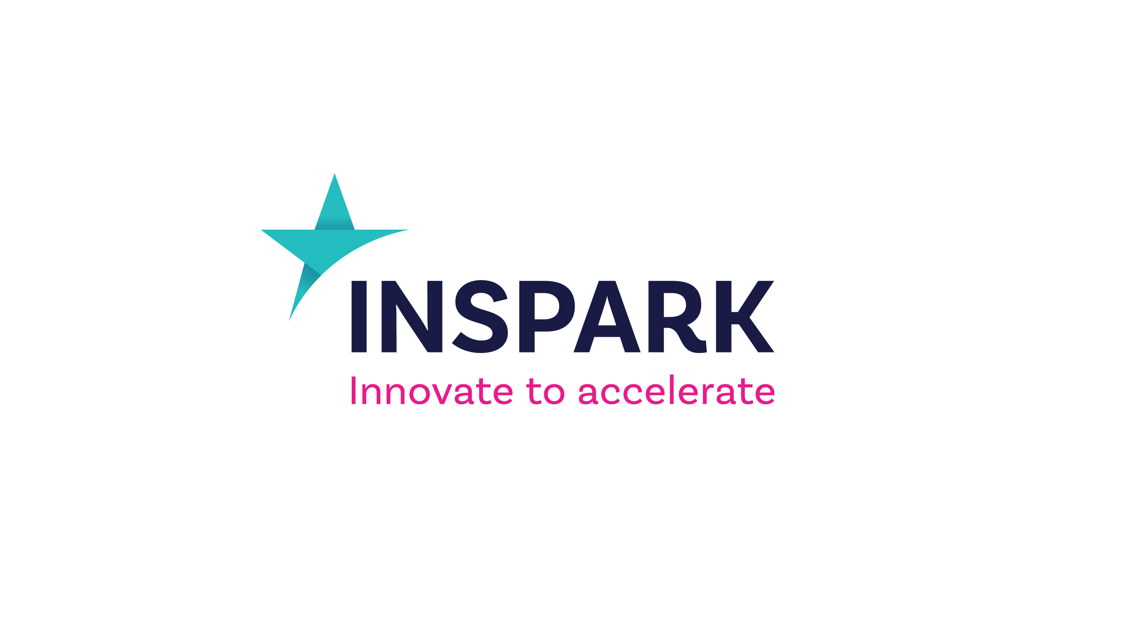
About US Johan Biere & Bram van den Klinkenberg
Work: InSpark
Twitter: @Johanbiere
Blog: talkingazure.com
Work: InSpark
Twitter: @BramKlinkenberg

Slide 3
Container-Based Docker Deployments In Azure Platform As A Service

Slide 4

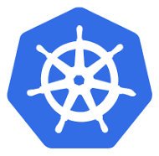

Agenda
Introduction
Azure Web App for Containers
The basics & Architecture
Demo & CI/CD Azure DevOps
Azure Kubernetes service
The basics & Architecture
Demo AKS & Scaling
Azure Container Instance
The Basics & Architecture
Demo ACI
Demo AKS scaling with ACI
Recap

Slide 5

Azure Platform as a service with Containers
Notes:
PaaS allows you to avoid the expense and complexity of managing the underlying application infrastructure and middleware or the development tools and other resources. You manage the applications and services you develop, and the cloud service provider typically manages everything else.

Slide 6
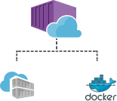
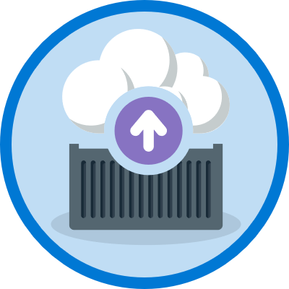

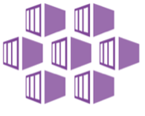
Azure container Paas Solutions
Azure Web App for Containers
Azure Container Instance
Azure Kubernetes Service

Slide 7
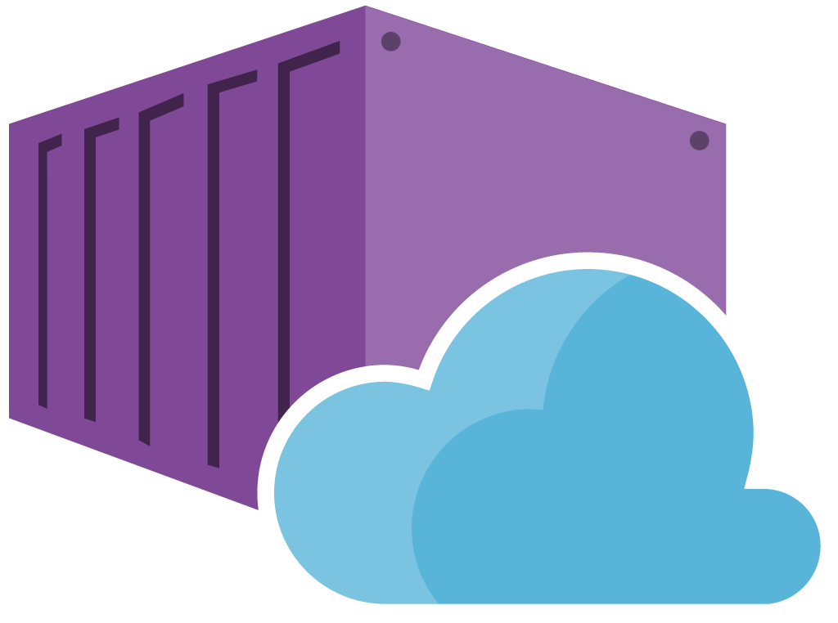


Web Apps for containers on Linux
Container Apps on Azure App Service are like peanut butter and chocolate

Slide 8
Azure Web App for containers (Linux)
A cloud-app platform for delivering modern apps within the Azure Cloud and services.
Comes as an integrated offering that offers features and capabilities of Azure Web App services
Enterprise Grade Apps
Fully Managed Platform
High Productivity Development

Slide 9
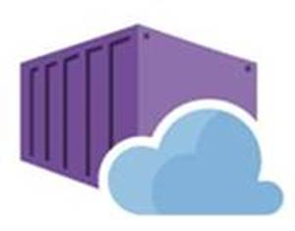

Web app for containers
01
02
03
High productivity development
Fully managed platform
Enterprise-grade apps
Deployment
with ease
CI/CD build
Deployment Center
Built-in auto scale and load balancing
High availability with auto-patching
Global data center footprint
Private registry
Support & docker hub
Testing in production
Staged deployment
with slots
Monitoring
and diagnosis
Backup and recovery
AAD integrated
Secure + compliant

Slide 10
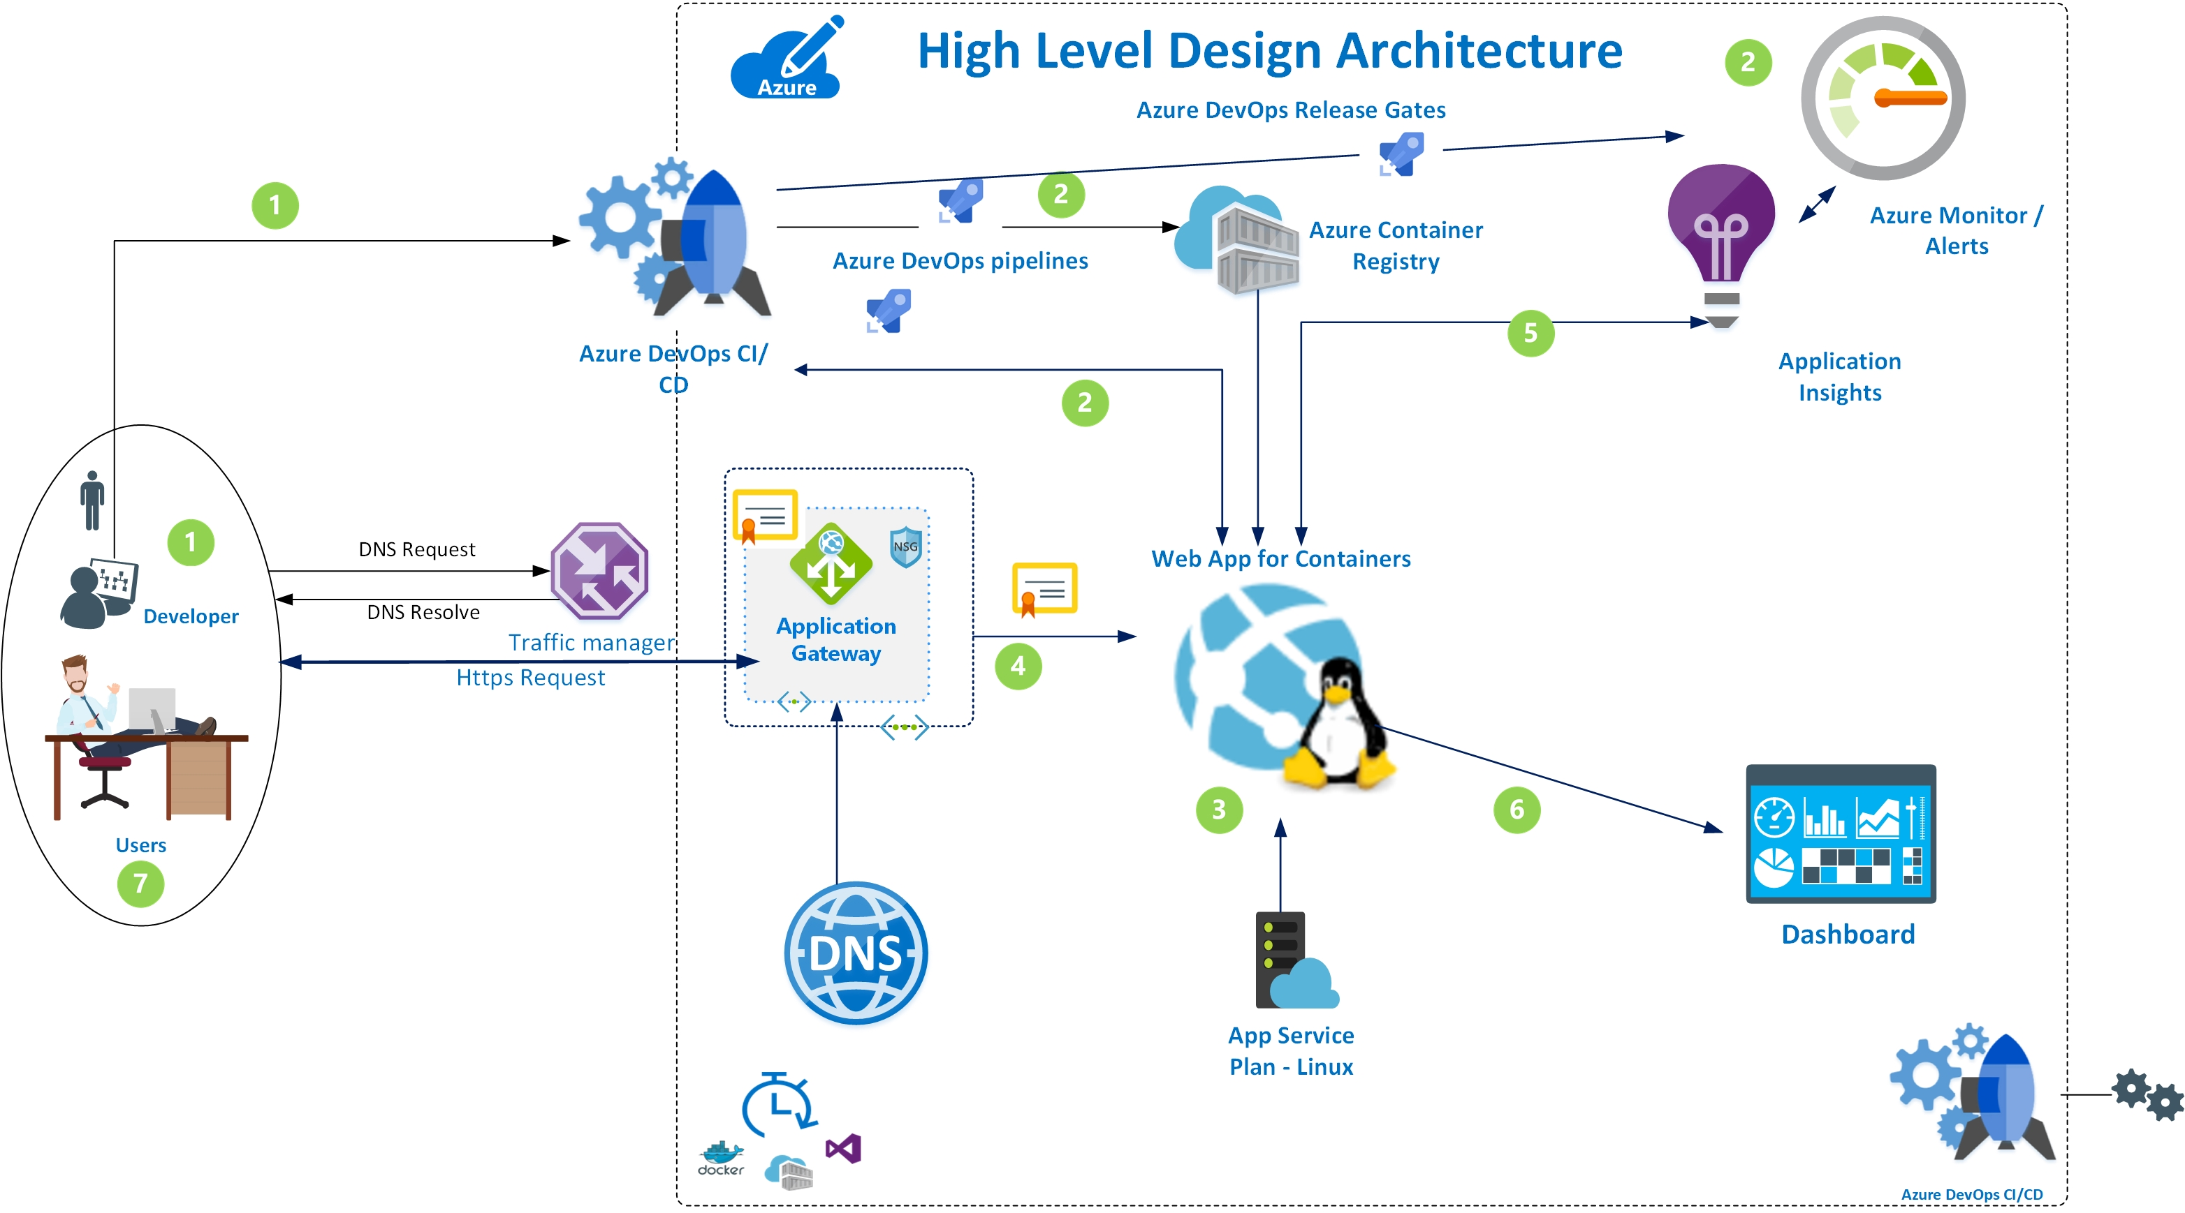

Slide 11
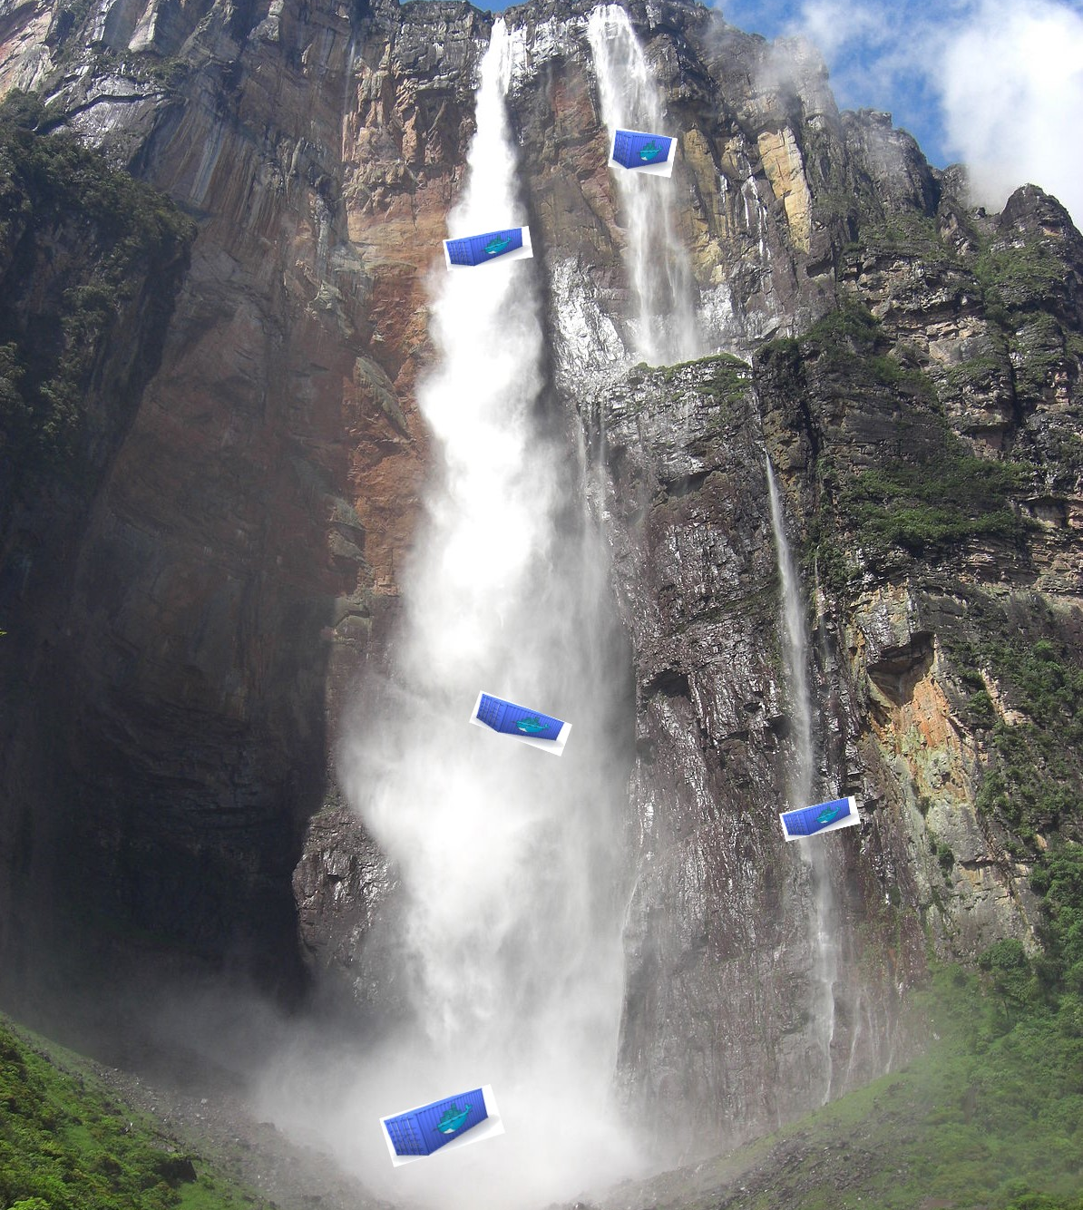
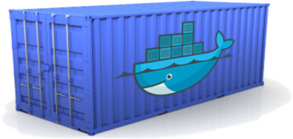
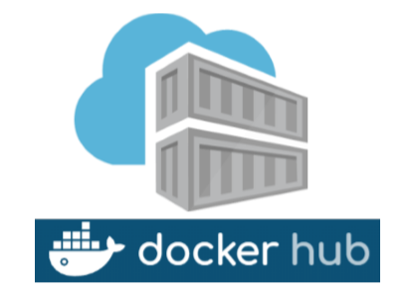
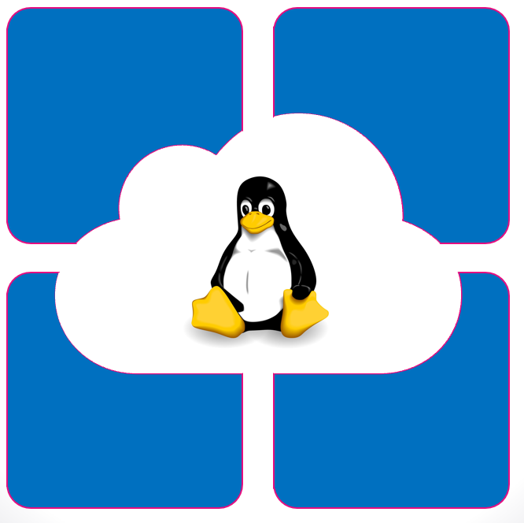
Deployment flow
Create Docker Image
Push Docker Images to registry
Apply deployments (CI/CD)

Slide 12

Demo Web App for containers with Azure DevOps CI/CD integration

Slide 13
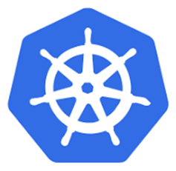
Azure Kubernetes services

Slide 14
Kubernetes
Kubernetes is an open-source (orchestration) framework for automating deployment and management of containerized workloads (microservices).
Orchestration:
Scheduling
Failover
Scaling
Networking
Service discovery
Health monitoring

Slide 15
History of kubernetes
2003/2004 - Designed by Google (Borg)
2014 - Introduced as Kubernetes as open-source version of Borg
2015 – Kubernetes v1.0
2016 – Kubernetes goes mainstream
2017 – Enterprise adoption & support (Azure, AWS)

Slide 16
Azure Kubernetes Services
AKS is a Azure Managed Kubernetes Platform
Hosted environment
Eliminates the burden of maintenance & operations
Master nodes are fully managed
Worker nodes are almost fully managed
“Have” to scale yourself
“Have” to reboot yourself (after updates)
“Quick” and easy deployment of a cluster
az cli, terraform, ansible, arm, pws

Slide 17
Azure Kubernetes Services
Integration with other Microsoft/ Azure Services, e.g.
Azure Container Registry
Azure Monitor (Log Analytics, Application Insights)
Monitoring cluster and/ or application
Key Vault
Secrets
PaaS db solutions
Storage
Azure Disks
Azure Files
Azure DevOps

Slide 18
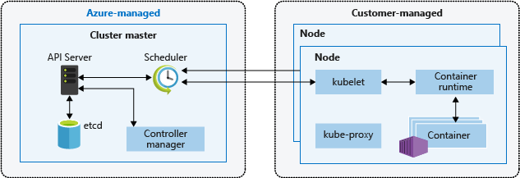
Architecture

Slide 19
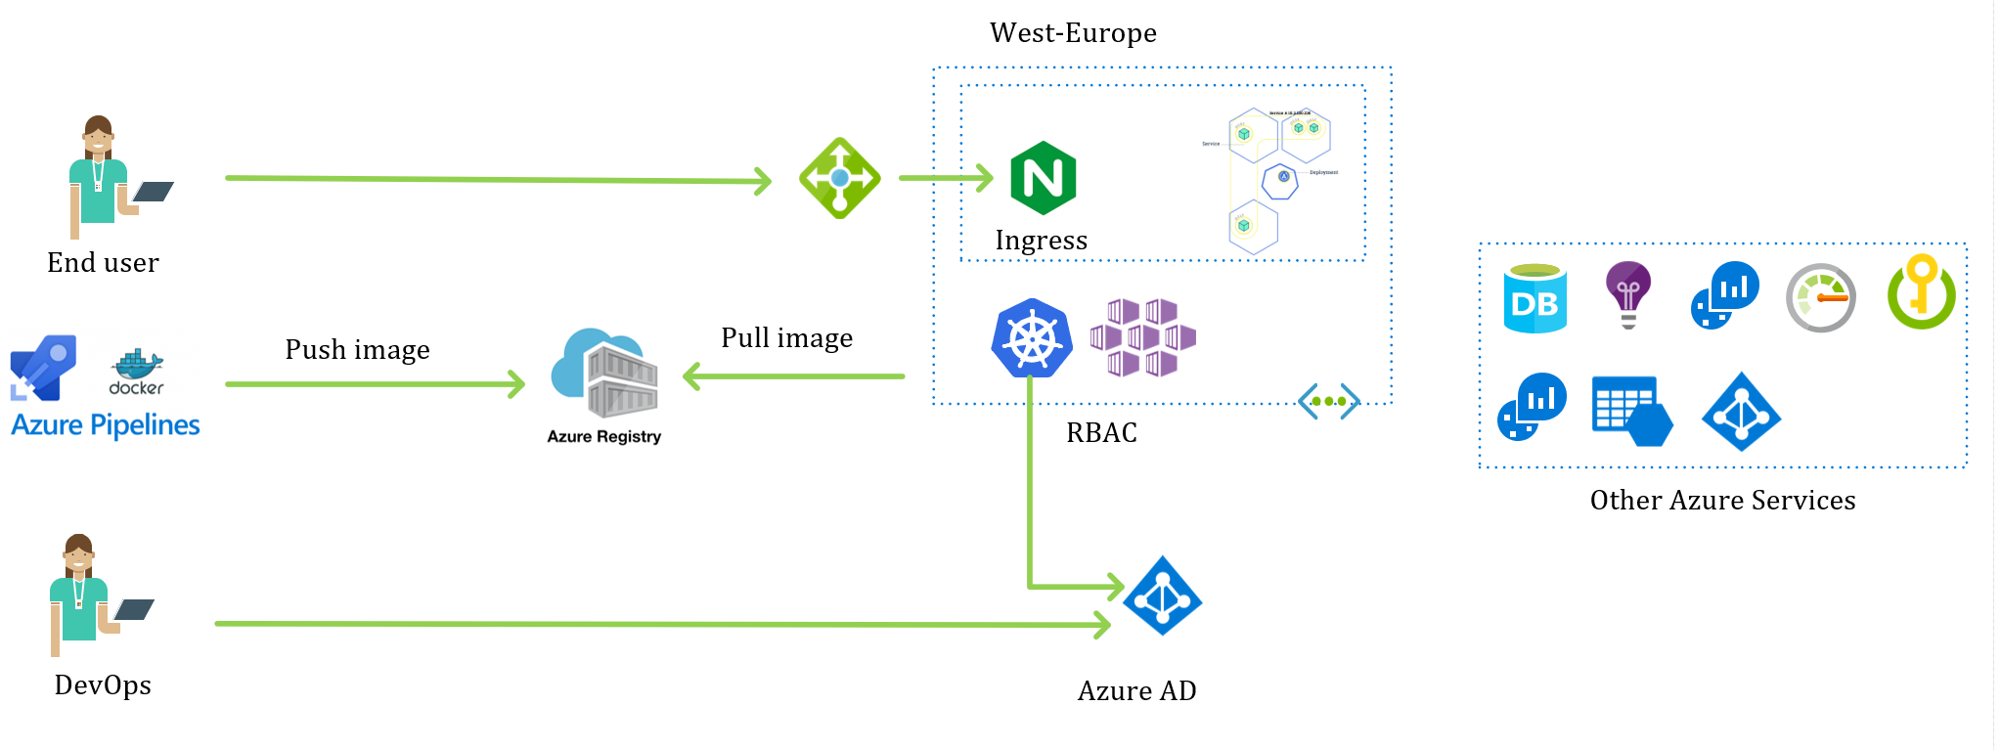
Architecture – (possible) Solution

Slide 20
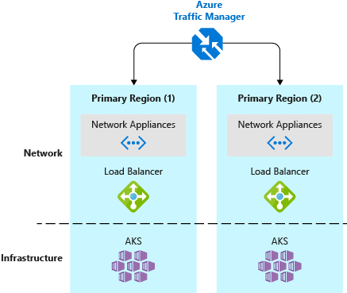
Architecture – (possible) HA Solution

Slide 21
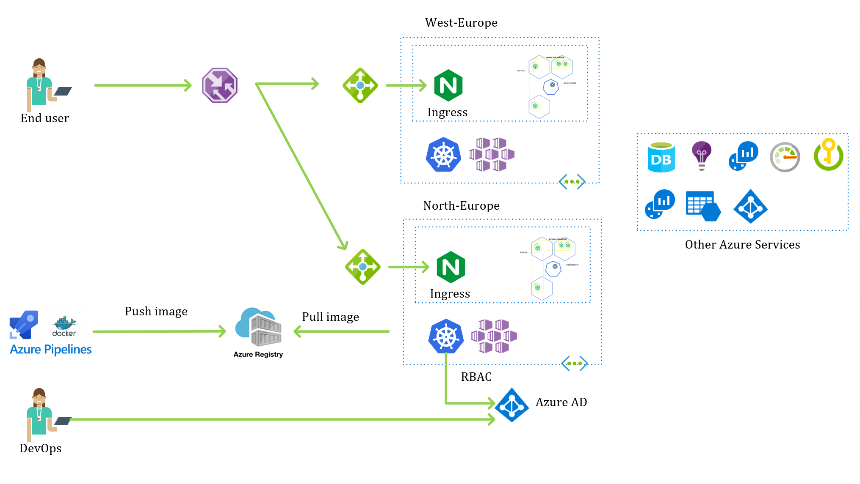
Architecture – (possible) HA Solution

Slide 22
Demo Deployment on AKS and scaling of the cluster

Slide 23
Azure Container Instance

Slide 24
Azure Container Instance
Easy and fast way to deploy containers
No infra to deploy/ provision and manage
Public endpoint
Linux & Windows containers!!
Persistent storage (Azure Files)
Custom Vnet (Preview)
1 or multiple containers in a container group
Pay per second
NOT AN ORCHESTRATOR!!

Slide 25
Azure Container Instance
Ideal for:
Simple applications
Task automation
Build jobs
Complementary to AKS

Slide 26
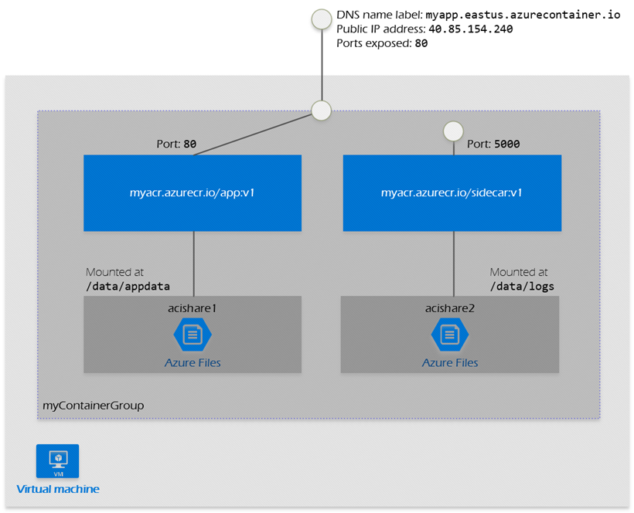
Architecture – Multi container group

Slide 27
Demo ACI DEMO AKS and scaling with ACI

Slide 28
Azure container Paas – WHEN/ WHAT
 | WebApp for containers | AKS | ACI
Complex microservices | -- | ++ | -
Scaling | ++ | + | ++
Ease of use | ++ | +/- | ++
Monitoring | ++ | ++ | +
Container management | + | ++ | +
Managed Identity | - | ++ | +
Windows containers (next to Linux) | ++ | +/- (ACI) | ++
Persistent storage | ++ | ++ | +
Custom Vnet | - | ++ | ++
Fully managed | + | +/- | ++

Slide 29
Thank you to our sponsors!
Gold Sponsors
Silver Sponsors
Community Sponsors

Slide 30
Track 1
11:05 – 11:50
Building Secure Cloud Applications With Azure Key Vault
Tom Kerkhove
Track 2
11:05 – 11:50
Governance: The forgotten key to managing Cloud
Rik Hepworth

